Slide 1
Intro to Git & GitHub
Chris Human ©2023

Slide 2
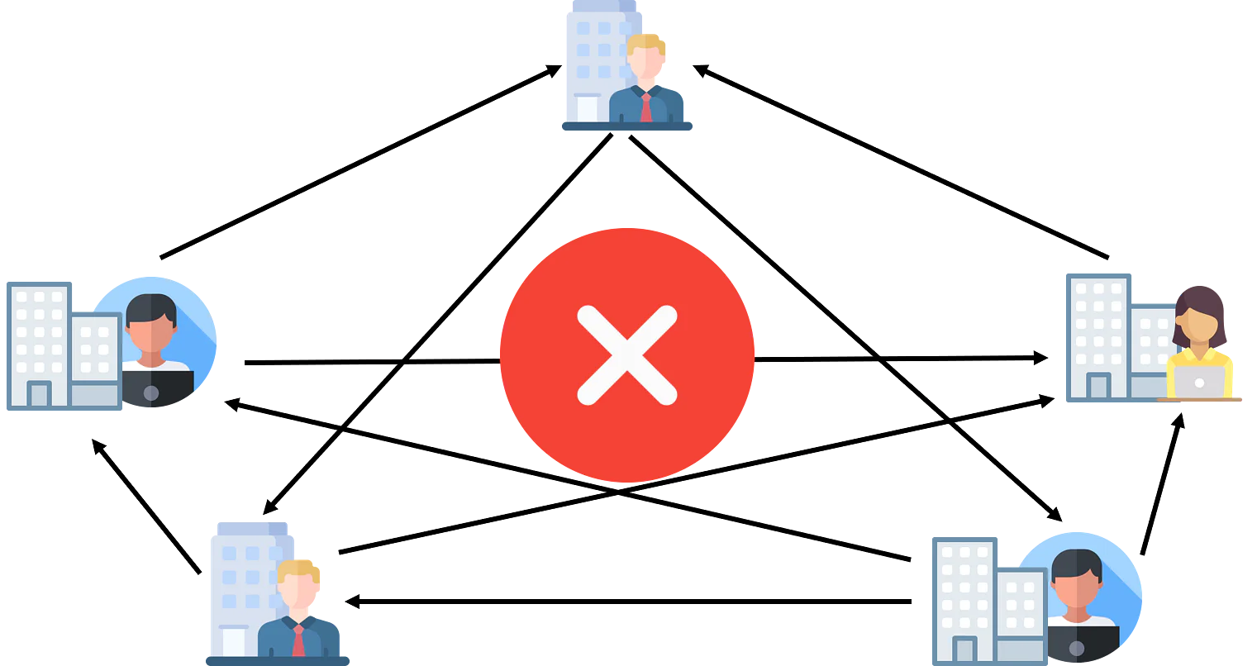

What / Why Git?

Slide 3
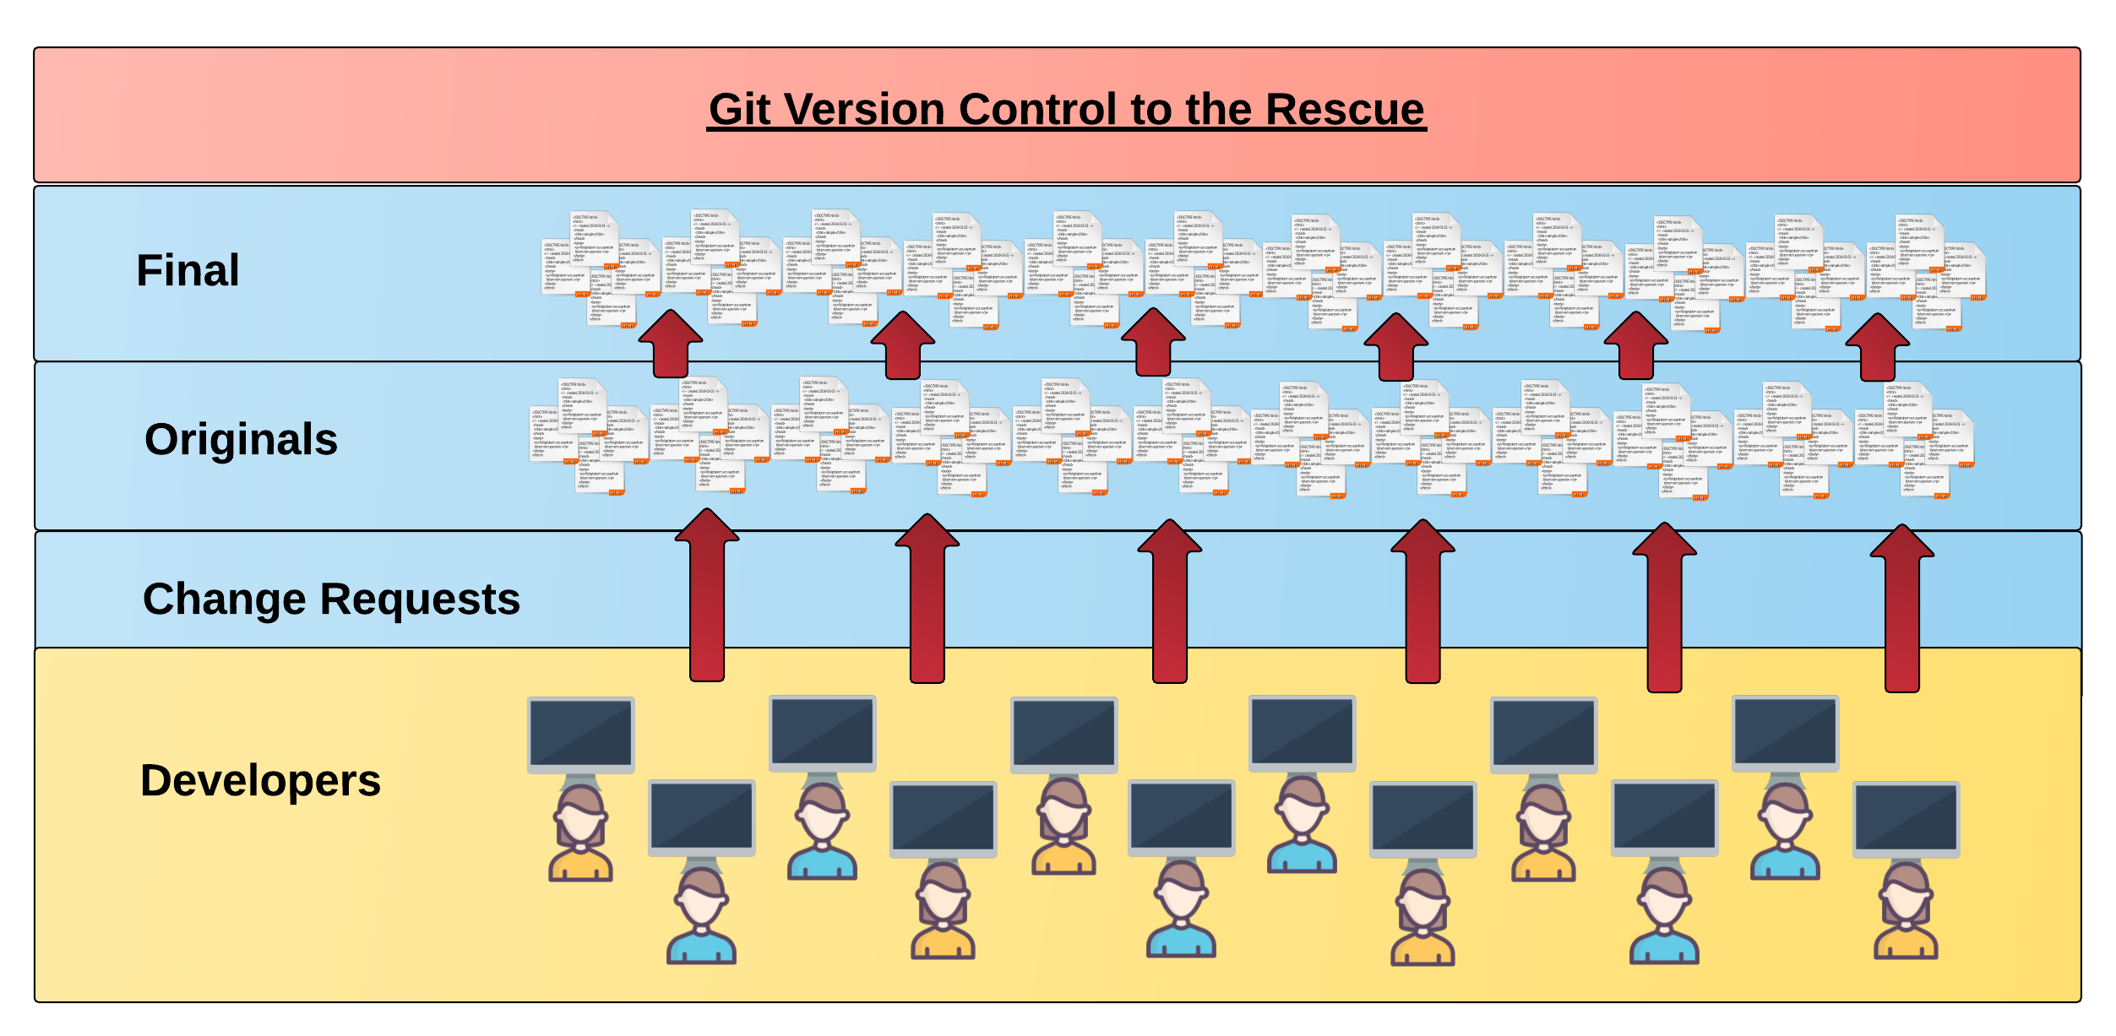
What / Why Git?
Modern web development is highly collaborative.
Teams are often extremely large and separated across the country — or planet.
Apps sometimes comprise hundreds or even thousands of files.

Slide 4



The Team’s Task
Task: Make a list of “best” movies
Programming Team:
Zack Snyder
Steven Spielberg
George Lucas

Slide 5

Zack & Steven make their edits
Coding his list…
Coding his list…

Slide 6
Different Solutions
<ul>
<li>Justice League</li>
<li>Man of Steel</li>
<li>300</li>
</ul>
<ul>
<li>Jurassic Park</li>
<li>Indiana Jones</li>
<li>E.T.</li>
</ul>

Slide 7
Resolution
“Lets settle on this…”
<ul>
<li>Zombieland</li>
<li>Home Alone</li>
<li>Babe</li>
</ul>

Slide 8
George writes his own stuff…
<ul>
<li>Star Wars</li>
<li>What else is there?</li>
</ul>

Slide 9
George overwrites teammates work…
DELETE. DELETE. DELETE.
<ul>
<li>Zombieland</li>
<li>Home Alone</li>
<li>Babe</li>
</ul>
<ul>
<li>Star Wars</li>
<li>What else is there?</li>
</ul>

Slide 10
The Group Project
Lesson: You should use Version Control…and be respectful of your teammates work.

Slide 11
Version Control
Git Version Control
Provides an organized system for managing code for when multiple developers work on a project at the same time.
The Benefits of Git
A process for resolving conflicts in code
Provides historical record of the different stages that a file/folder/project has gone through

Slide 12
The Group Project
Branch = copy
Master Branch
Zac’s branch
Steven’s branch
George’s branch

Slide 13
The team goes to work
<ul>
<li>Justice League</li>
<li>Man of Steel</li>
<li>300</li>
</ul>
<ul>
<li>Jurassic Park</li>
<li>Indiana Jones</li>
<li>E.T.</li>
</ul>

Slide 14
Zack pushes first
Master branch
Zack pushes (uploads) his code changes into the master branch.
No code conflicts
1
Zack’s branch

Slide 15
Steven’s edits are ready
Rule: Pull first, then push your changes
Ok

Slide 16
Steven conflicts with the master branch
Master branch
1
<ul>
<li>Justice League</li>
<li>Man of Steel</li>
<li>300</li>
<li>Jurassic Park</li>
<li>Indiana Jones</li>
<li>E.T.</li>
</ul>
Git sees a conflict
Steven’s branch

Slide 17
Steven resolves
<ul>
<li>Justice League</li>
<li>Man of Steel</li>
<li>300</li>
<li>Jurassic Park</li>
<li>Indiana Jones</li>
<li>E.T.</li>
</ul>
<ul>
<li>Zombieland</li>
<li>Home Alone</li>
<li>Babe</li>
</ul>
Steven’s branch

Slide 18
Steven fixes and pushes
Master branch
Steven pushes (uploads) his revision to the master branch.
No code conflicts
1
2
<ul>
<li>Zombieland</li>
<li>Home Alone</li>
<li>Babe</li>
</ul>
Steven’s branch

Slide 19
George begins his work
Rule: Pull first, then push your changes
Meh.

Slide 20
George pushes
Master branch
George pushes (uploads) his revision to the master branch.
No code conflicts
NOT WHAT WE WANT
1
2
3
<ul>
<li>Star Wars</li>
<li>What else is there?</li>
</ul>
George’s branch

Slide 21
If George had pulled first…
Conflict!
<ul>
<li>Star Wars</li>
<li>What else is there?</li>
</ul>
<ul>
<li>Zombieland</li>
<li>Home Alone</li>
<li>Babe</li>
</ul>

Slide 22
Rollback
Master branch
1
2
3
4
Zack rolls back the code to an earlier version

Slide 23
The Group Project
Lesson:
You should use Version Control!

Slide 24

So…What is GitHub?
GitHub is a web based hosting service to store code online
It allows developers to pull (download) code or push (upload) code to the same repository (directory)
It also allows developers to view histories of code changes and to track issues

Slide 25

Pulling and Pushing to GitHub
1
2
3
4
GitHub Branch
Pull Code
Push Code
Pull Code
Pull Code
Push Code
Pull Code
Push Code

Slide 26
Demo

Slide 27
Basic Git Commands
At its most basic, there are 5 git commands to get started:
git clone
git add
git commit
git pull
git push
— copies an entire repo
— adds a file for inclusion to be tracked by git
— notes a change to a local repo
—downloads freshest version of repo
— sends changes to hosting service (e.g. GitHub)

Slide 28
Your Turn!
Activity: Git Add, Commit, Push
Suggested Time: 20 min
Assignment:
Using GitHub and the Command Line:
Create a new public GitHub repository and name it whatever you like. Be sure to check the box for “initialize this repository with a README”
Next, clone the repo to your local directory
Then create a text file inside the local directory
Add, Commit, and Push the code to GitHub
Bonus:
Working with your group members, fork their repository to your own GitHub account. Clone this forked repo to your local directory
Add, Commit, and Push a text file back to your forked copy of the repo
Finally, submit a pull request (PR) to send your changes to your group member’s repo.

